Slide 1
MapReduce and Apache Spark
Harshini Amarasena
239145B

Slide 2
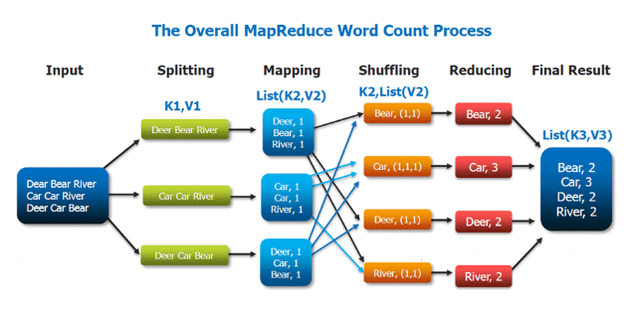
MapReduce
A software framework for easily writing applications which process vast amounts of data in-parallel on large clusters.

Slide 3
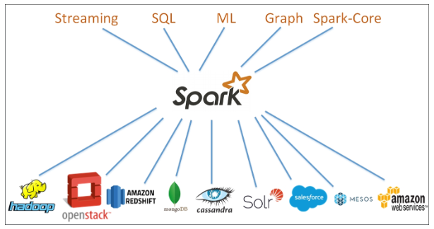
Apache Spark
Apache Spark is an open-source, distributed processing system used for big data workloads. It utilizes in-memory caching and optimized query execution for fast queries against data of any size.

Slide 4
Demo on loading, processing and querying

Slide 5
Fast Process
Apache Spark | Hadoop MapReduce
In memory data processing Facilitate all data processing requirements (Real Time, Batch, Graph) | Batch Processing persist data back to the disk after every Map or Reduce action
No any synchronization barrier | Have synchronization barrier
Execute batch processing 10 -100 times faster | Not using memory of the Hadoop cluster to the maximum

Slide 6
Based on Delayed Flights Dataset

Slide 7
Ease of Use
Apache Spark | Hadoop MapReduce
Easier than Hadoop code | Complex code
Supports interactive Mode | No interactive Mode
pre-built APIs for Java, Scala, and Python Easy to write user defined functoins | written in Java and is infamously very difficult to program

Slide 8
Conclusion
Due to speed and developer friendly spark APIs ,Spark has become the framework of choice when processing big data.

Slide 9
Thank You.

